Slide 1
ACh
DA
 | DA aGOnist | DA anTAGonist
Cause | Increase DA | Decrease DA
Treat | Parkinson's L-DOPA + Carbidopa DA Agonist MAO-B inhibitor COMT inhibitor | Antipsychotics TCA clozapine, risperidone, olanzapine quetiapine ziprasidone
Nausea/Vomiting | Causes NV | Help NV metoclopramide droperidol domperidone promethazine
Other problems | If too much DA Neuro malignant syndrome Hallucinations

Slide 2
Parkinson's Disease IPD
Low Dopamine
Symptoms:
Tremor at rest, rigidity, bradykinesia (slow movement) and postural instability (balance)
No lab test are available to diagnose IPD
Dyskinesia Vs Tremor
Dyskinesia: associated with too high DA levels → too much movement
Freezing: Patients may report that their "feet suddenly feel stuck to the floor"
Cause
1. Not 100% known: Idiopathic Parkinson's disease IPD (having no specific known cause) but is likely the result of aging, genetic and environment.
2. Nigrostriatal pathway: degeneration of neurons in the substantia nigra that project to the striatum
Clinical symptoms arise as losses of DA neurons exceed 65%
3. Lewy bodies: neuronal cytoplasmic filamentous aggregates . Progresses to midbrain → motor problems
3. Autonomic ganglia, basial ganglia, spine and neocortex
5. Drugs that block D2 receptors such as antipsychotics
Epidemiology
Occurs most often between 55 – 65 yoa
1 – 2 % of population > 65 yoa ; increased incidence > 84 yoa
Dementia in the elderly; treatment associated disturbances:Hallucinations, Depression

Slide 3
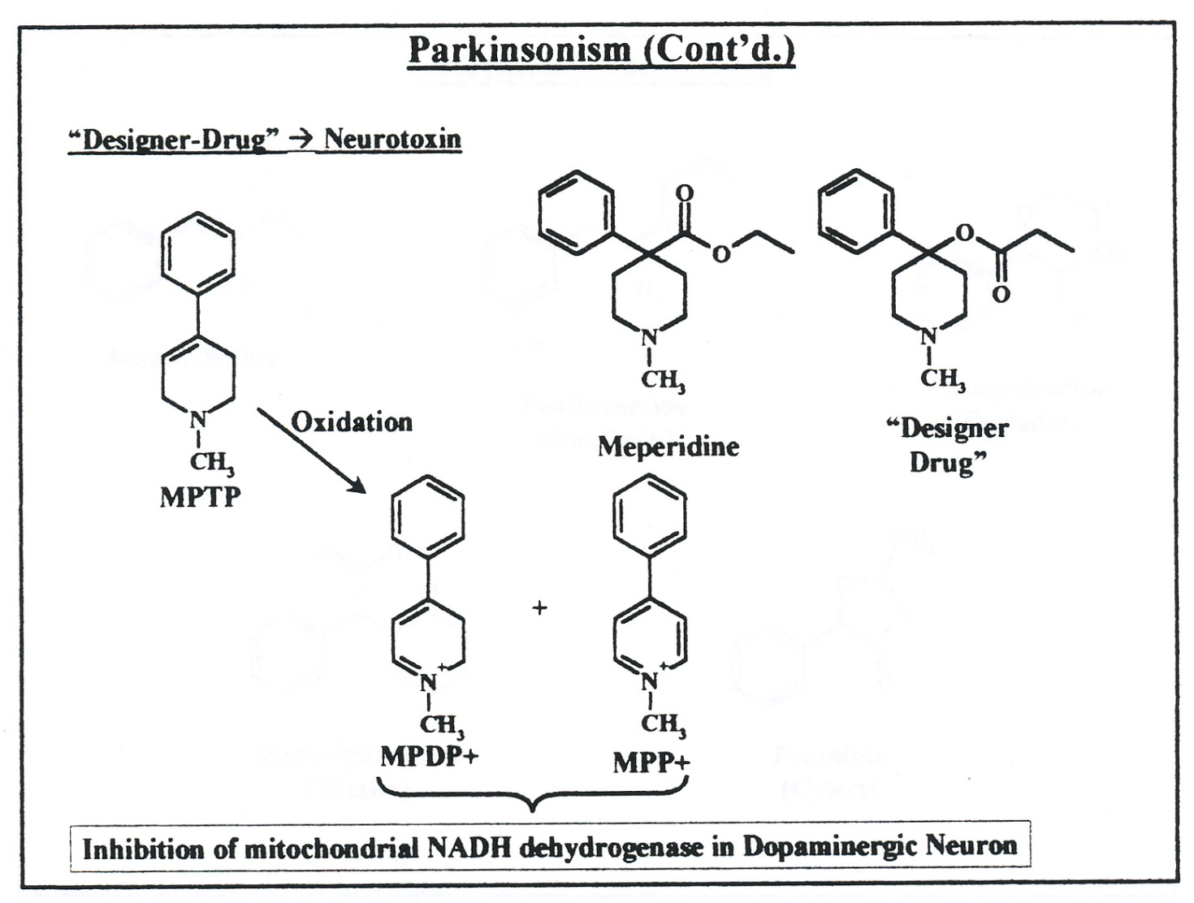
Drug that cause Parkinsons
MPTP (1-methyl-4-phenyl-1,2,3,6-tetrahydropyridine) is a neurotoxin precursor to MPP+, which causes permanent symptoms of Parkinson's disease by destroying dopaminergic neurons in the substantia nigra of the brain
MPP⁺ is toxic to neurons by inhibiting mitochondrial complex 1 of the electron transport chain, which results in the generation of excessive reactive oxygen species and cell death.
Discovery: 23 year old collage graduate student from Maryland . Died 18 months after self injection. Cause is damage to dopaminergic neurons in substantia nigra
MAO-B

Slide 4
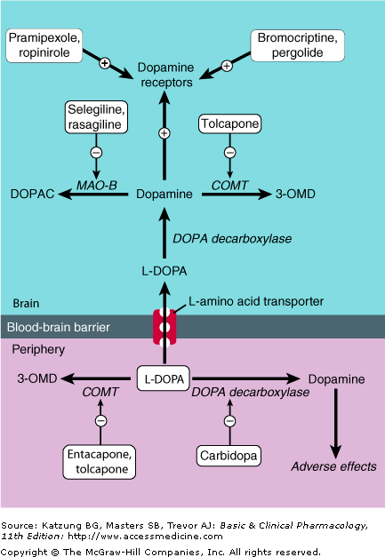
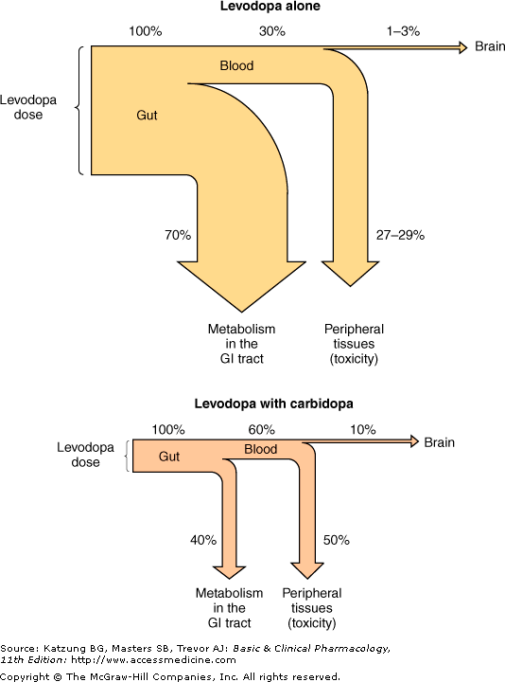


Treatment of IPD Symptoms
No cure
L-DOPA: only 1-3% enters CNS
L-DOPA + Carbidopa: 10% enters CNS
Notes:
Amatadine

Slide 5
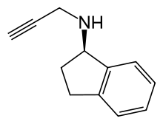

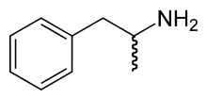
Drugs
MAO-B inhibitor: metabolize DA (not NE nor 5-HT)
Treat: Initial monotherapy if patient has no functional impairment
prevents fluctuation and prlongs effect of L-DOPA
Drugs:
Selegiline (5 mg BID) also used for depression
Mix between Amphetamine + MAO-I
Rasagiline: second generation selective MAO-B 1mg/day monitors motor fluctuations
Metabolized by CYP2C19 b/c of its amphetamine like structure
Carbidopa/L-DOPA
Treat: Old person with Severe functional impairment
most effective drug for symptomatic treatment of IPDs
Regardless of what the initial therapeutic agent is, ultimately all patients with IPD will require L-dopa
Mechanism: Cross BBB then converted to dopamine
Drugs:
L-DOPA (100 mg 3 times a day. Up to 6000 mg/day = DAMN!)
Carbidopa: DOPA decarboxylase inhibitor (25 mg 3 times a day)
L-DOPA + Carbidopa reduces the dose of L-DOPA by 75%
PK:
L-DOPA is transported via amino acid transport system in duodenum. L-DOPA is not bound to plasma proteins (can take
. with meals)
Cons: Drug wears off as early as 6 months b/c storage and synth of dopamine decreases.
Selegiline
Rasagiline

Slide 6
Dopamine AGOnist
Treat: minimize occurrence of “wearing off”
Used to treat younger patients b/c older patients might have hallucinations
To treat acute ‘off’ episodes by SQ administration (onset within 10 min)
Mechanisms: directly stimulates the under functioning dopamine receptors in the striatum
Drugs: Ergot-derived agonist. Ergot is a type of fungi. A precursor of LSD (lysergic acid)
Bromocriptine (10-20mg/dose) also elevates mood
Drugs: Nonergot aGOnist (safer than ergot, however one must titrate very slowly 0.125mg TID then increase q5-7d)
Pramipexole
Ropinirole
Cons: not good with patients with dementia
excreted renally
Drug: Pramipexole
Treat: Advanced stage of Parkinsons
Rescue drug when L-DOPA is not effective
BA 90%
Protein bound 50% → elim Renally
Long half life: 12hr
Dose Pramipexole according to CrCL
CrCl > 60 0.125 mg TID
CrCl 35 – 40 0.125 mg BID
CrCl 15 – 35 0.125 mg qDaily

Slide 7
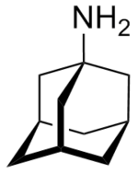
Amatadine
Treat: used to stabalize L-DOPA’s fluctuations
Mechanism: inhibition of glutamatergic N-methyl-D-aspartate (NMDA) receptors
normally NMDA would increase Ca into the cell → causes the cell to swell → Apoptosis
Drugs:
Adamantane
Memantine
Monitor CrCl b/c drug is eliminated renal and any signs of confusion (messes w/ your noggin)
COMT inhibitors
Treat: Extend the effects of L-DOPA and are indicated for managing wearing off
Mechanism: Reduce conversion of L-DOPA to dopamine in periphery (Inhibit DOPA decarboxylase)
Drugs
Entacapone (200mg 8times/day!!! It waa)
cons: short half life
Acts only in periphery COMT
Tolcapone: inhibits two COMT: in peripheral and central → last resort
Pros: acts on periphery and CNS COMT
dose: 100-200 mg PO TID
Dangers: Fatal hepatotoxicity
GABA-B aGOnist
Treat: muscle spasticity
as effective as diazepam in reducing spasticity and causes less sedation.
Mechanism: hyperpolarize neuron by promoting K efflux → less NT upon stimulus
Drugs
Baclofen pump
Dosing: 15 mg BID Max: 100mg/day

Slide 8
Alpha 2 Agonist
Treat:
Mechanism: Alpha 2 aGOnist → inhibit release of NT and ACh
Drug
Tizanidine
Dose: 2 mg max: 36 mg/day

Slide 9
Drug (class) Dose Max
L-DOPA 100 mg TID 6 g/day
Carbidopa (decarboxylase inhibitor) 25 mg TID
Apomorphone (DA agonist) 3-6 mg SQ
Bromocriptine (ergoline DA agonist) 1.25 mg qday 10-20 mg/dose
Pramipexole (Nonergot DA aGOnist)
CrCl > 60 0.125 mg TID
CrCl 35-60 0.125 mg BID
CrCl 15-35 0.125 mg qDay
Amatidine (inhibit NMDA) 100 mg BID 300 mg
Baclofen (GABA-B agonist) 15 mg BID initial 100 mg/day
Tizanadine (alpha 2 agonist) 2 mg 36 mg/day
Selegiline, Sasagiline (MAO-B)
Tolcapone (COMT-I)
Notes:
Ti = 2
Back has 33 bones (33/2) = 12 ish mg BID

